Slide 1
AKS Kubernetes networking on Azure
Notes:
These Learn modules are part of the AZ-204: Implement Azure App Service web apps (https://learn.microsoft.com/training/paths/create-azure-app-service-web-apps/) learning path.

Slide 2
Agenda
Azure AKS Network
AKS with Kubenet
AKS with Azure Network
Networking Options with AKS

Slide 3



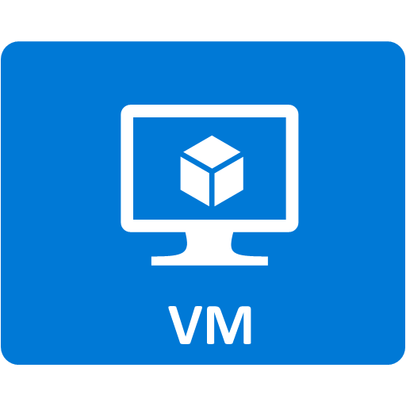








A Scenario for AKS Deployment
Abc Ltd , already using Azure and details is here
Customer App (Subscription)
Backend Subnet
App Subnet
Net-Subnet
/Product
/Service
VPN
Bastion Sub
Prod VNet
Network VNet

Slide 4


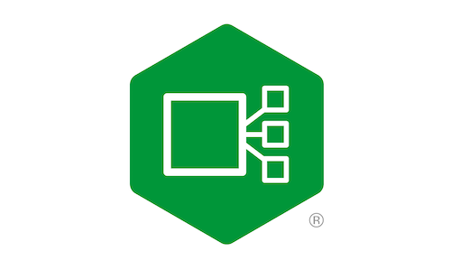


Proposed Deployment.
Abc Ltd , already using Azure and details is here
Customer App (Subscription)
Network VNet
Web App Traffic
Backend Subnet
App Subnet
Net-Subnet
Container
App Traffic
/Product
/Service
Prod VNet
VPN
Bastion Sub
AKS Subnet
Ingress Controller
Customer1NS
Customer2NS
Namespace
Kube-System
Customer3NS
AKS VNet

Slide 5
Azure AKS Network
Notes:
https://learn.microsoft.com/training/modules/introduction-to-azure-app-service/

Slide 6
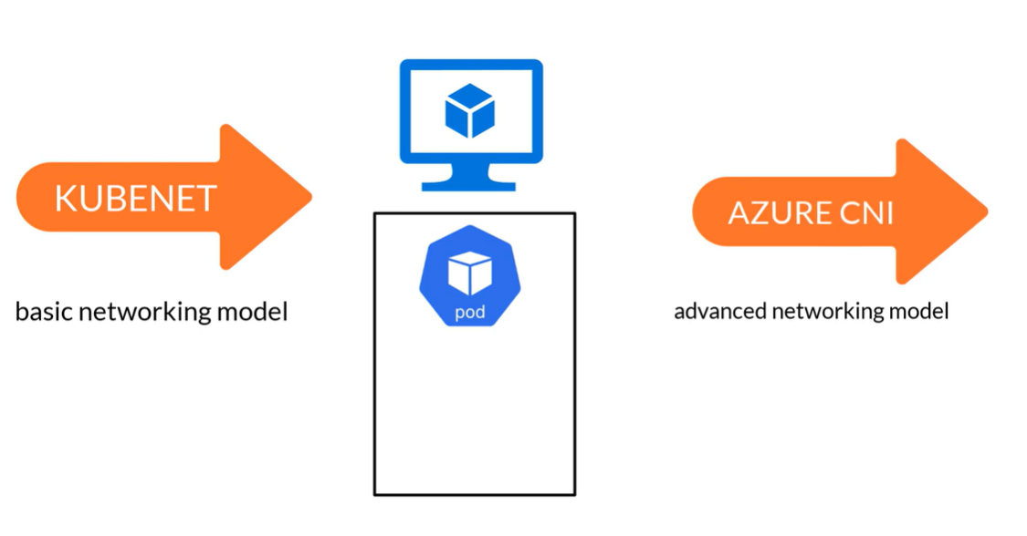

Slide 7
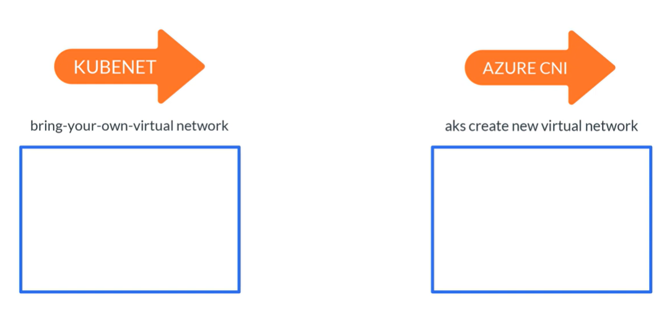

Slide 8
AKS With Kubenet
Notes:
https://learn.microsoft.com/training/modules/configure-web-app-settings/

Slide 9
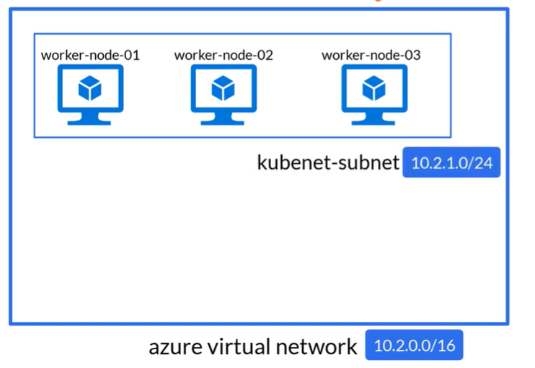
Kubenet

Slide 10
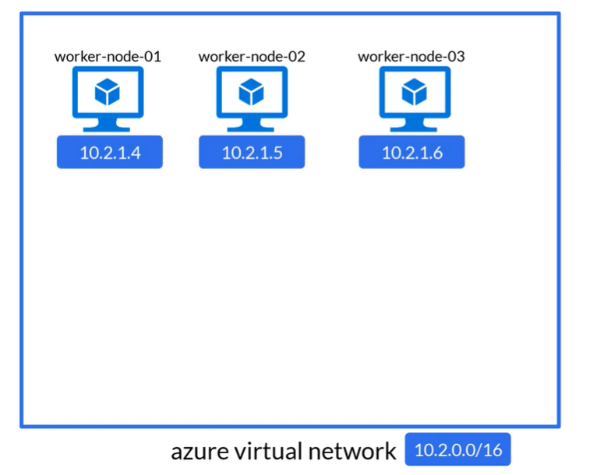
Kubenet

Slide 11
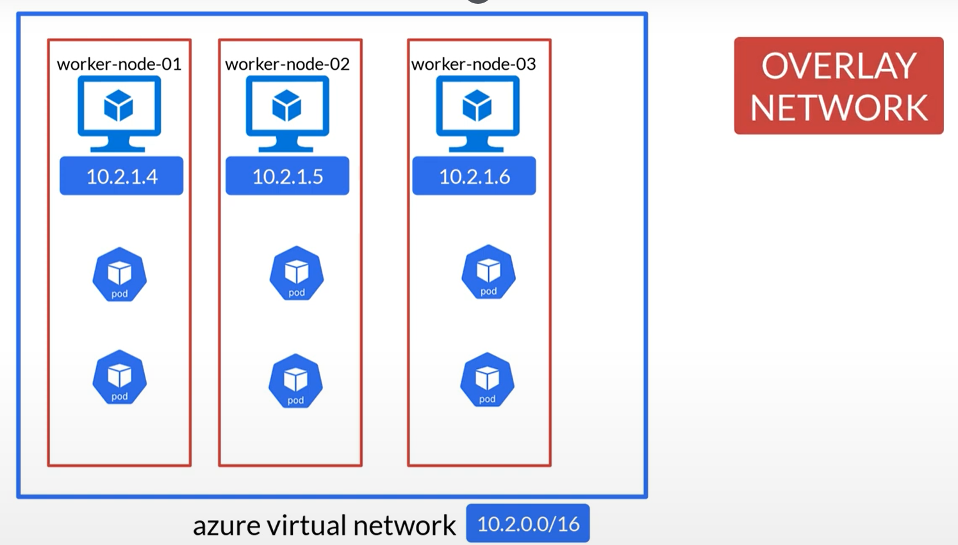
Identity Everywhere

Slide 12
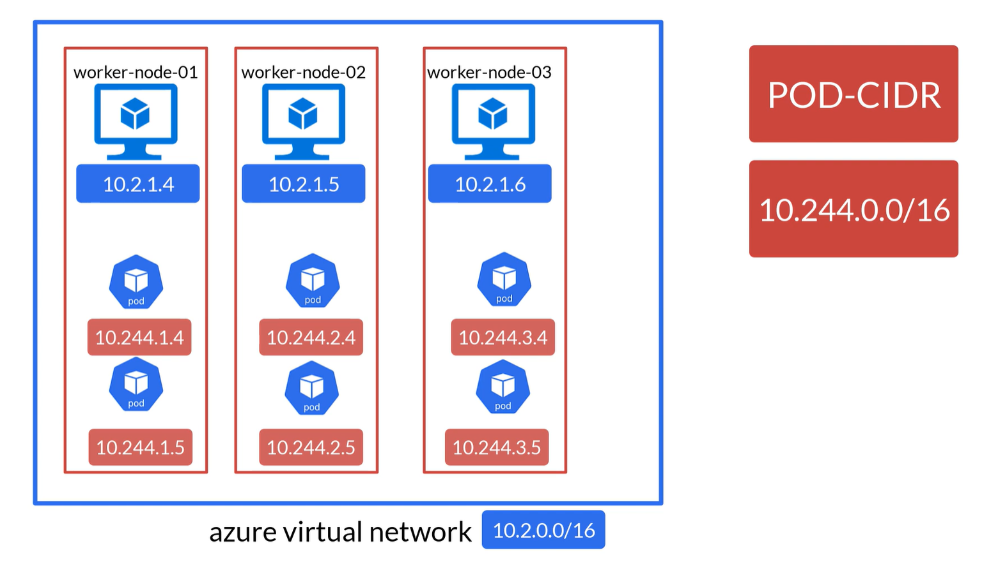

Slide 13
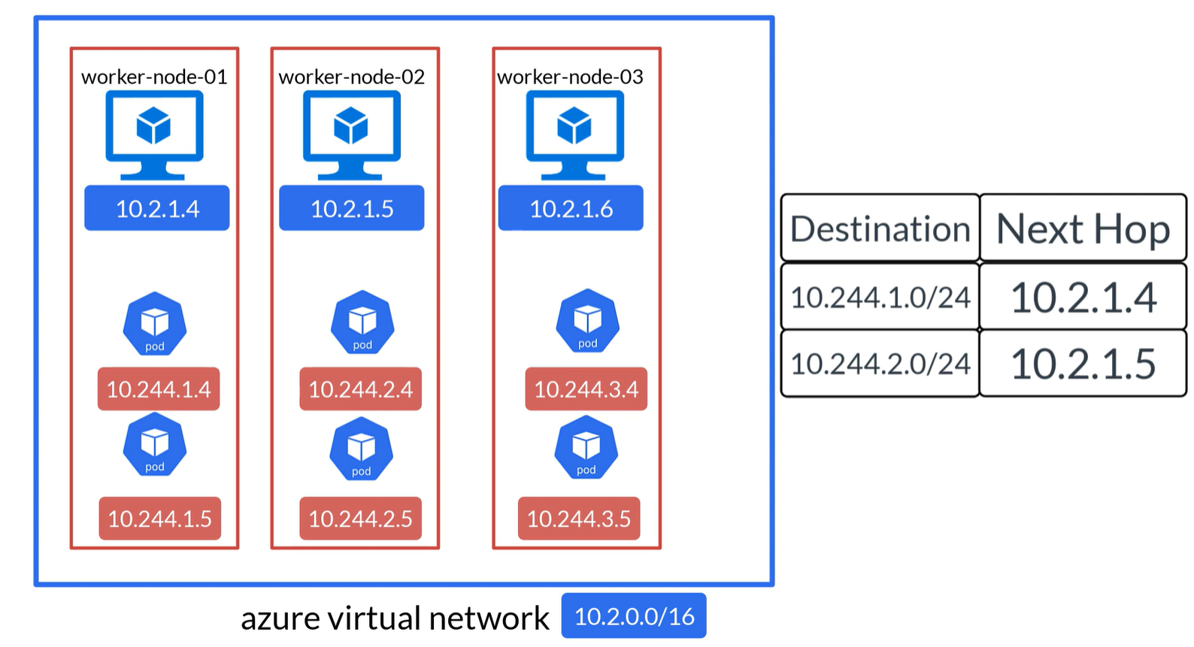

Slide 14
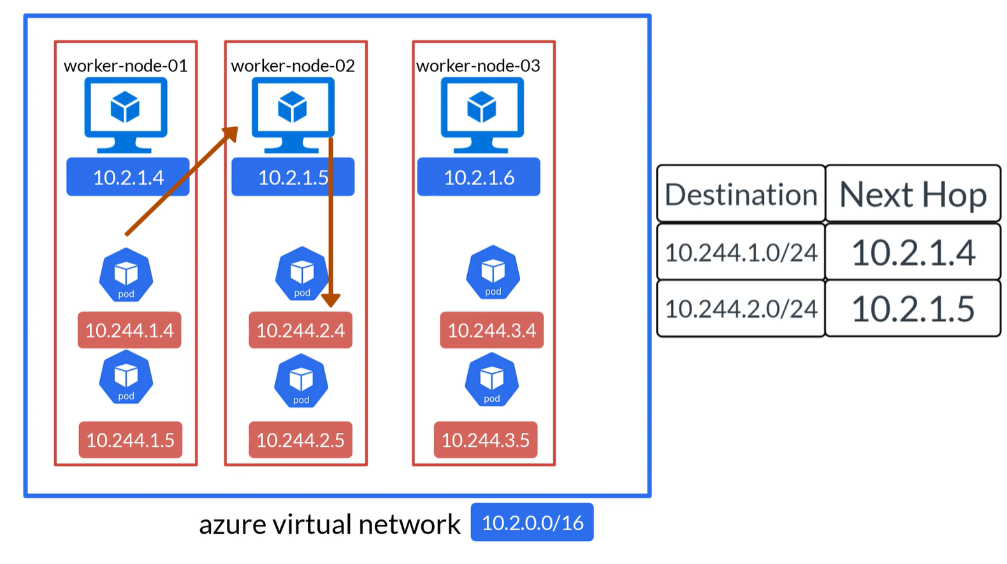

Slide 15
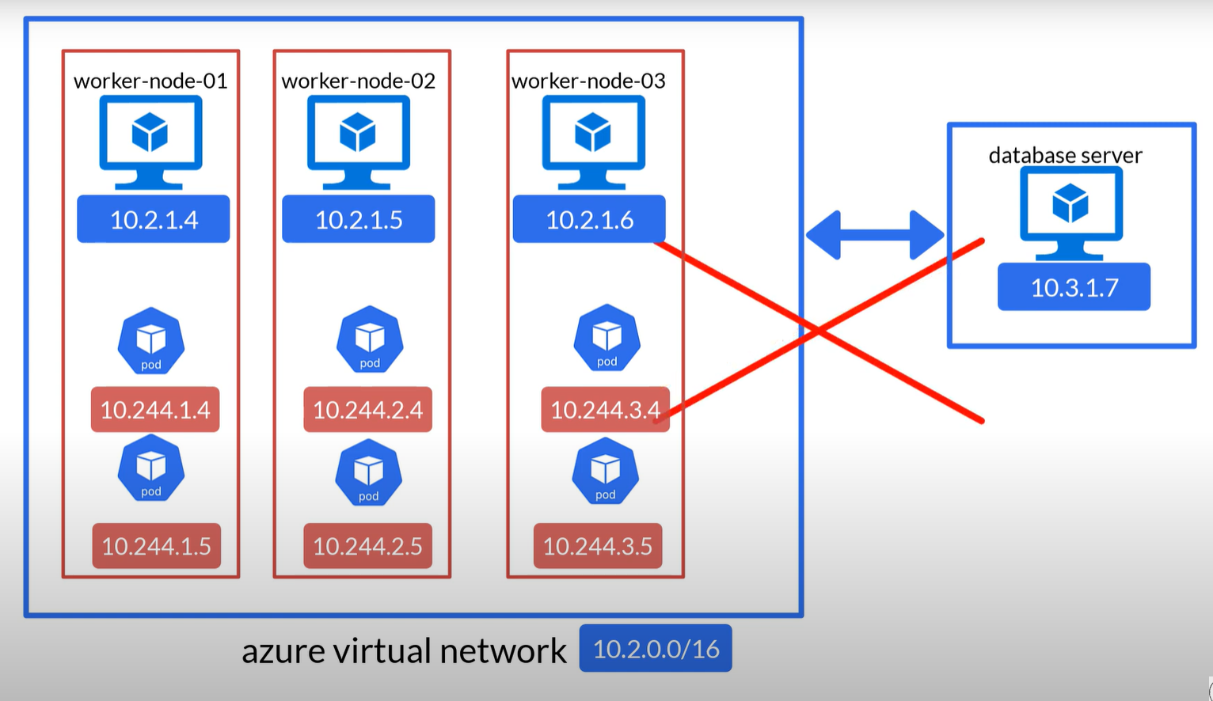

Slide 16
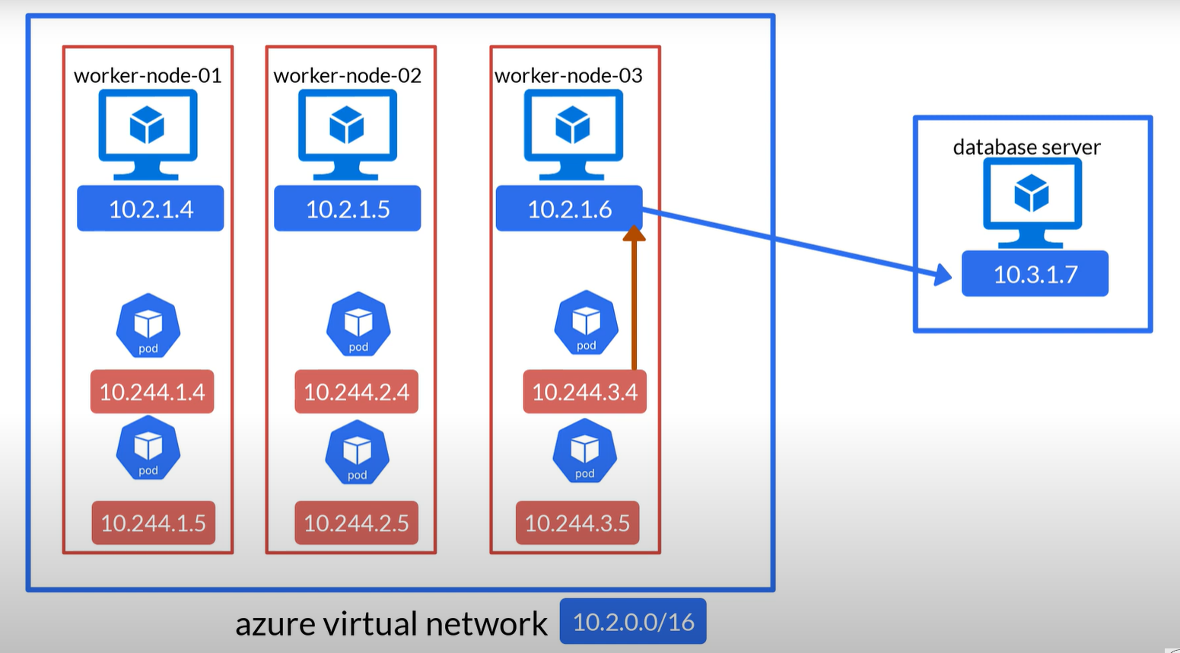

Slide 17
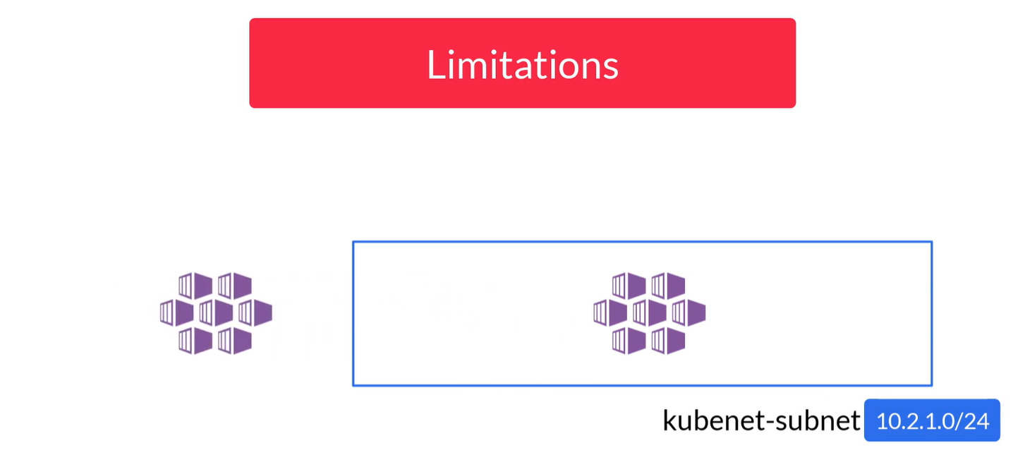

Slide 18
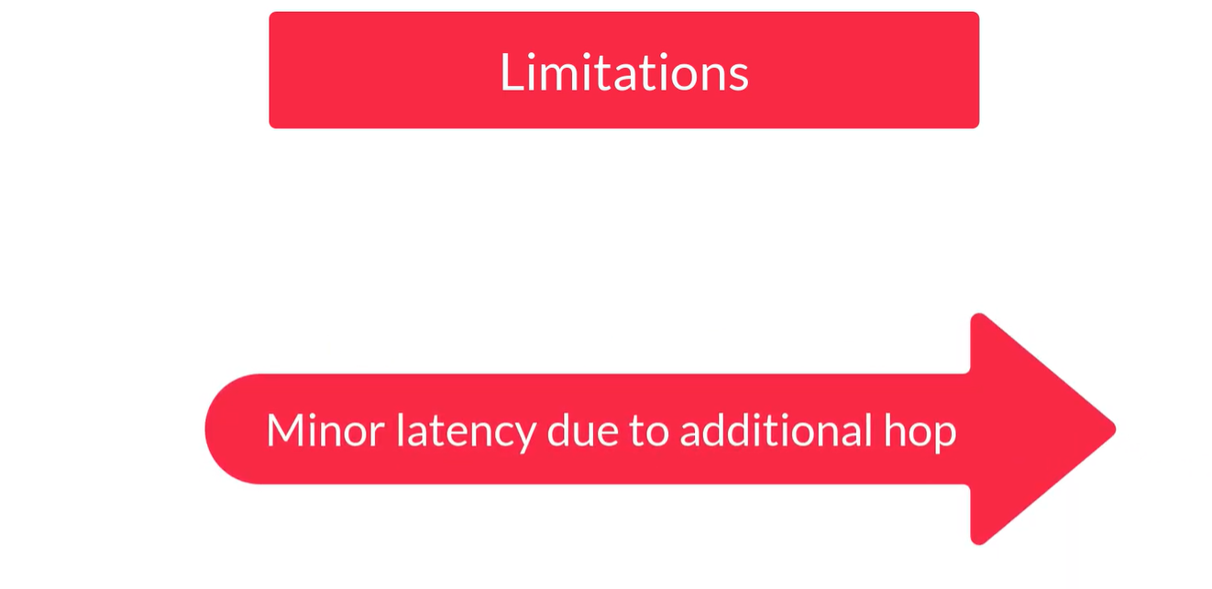

Slide 19
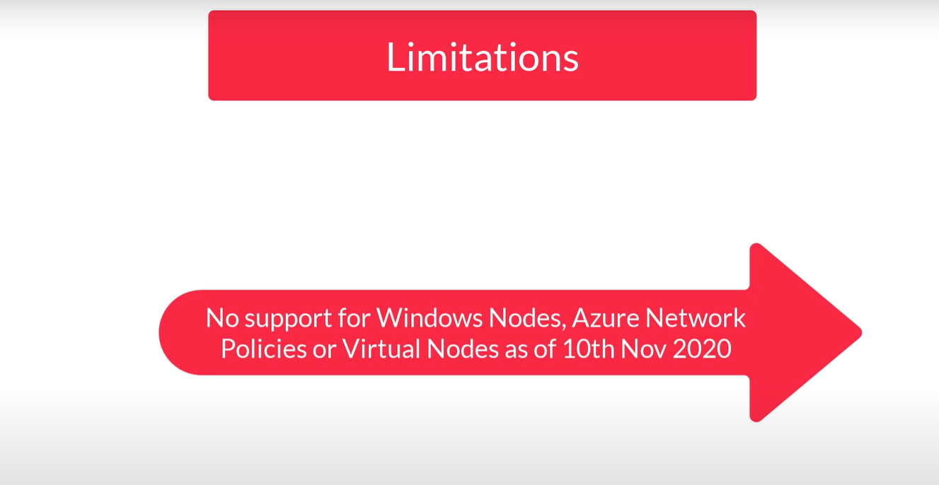

Slide 20

Why to Use Kuebent

Slide 21
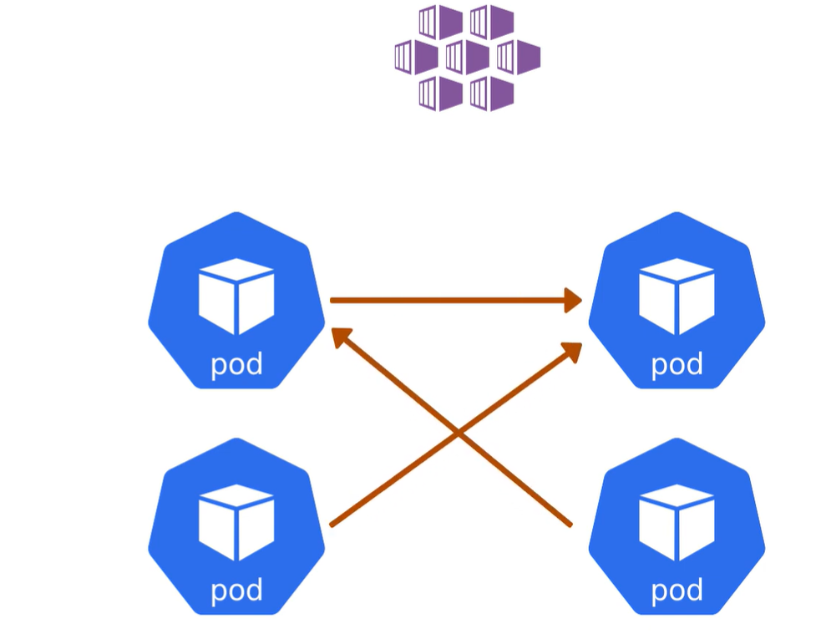
Why to Use Kuebent
When only Requirement to pod to pod communication

Slide 22
AKS With Azure Network
Notes:
https://learn.microsoft.com/training/modules/configure-web-app-settings/

Slide 23
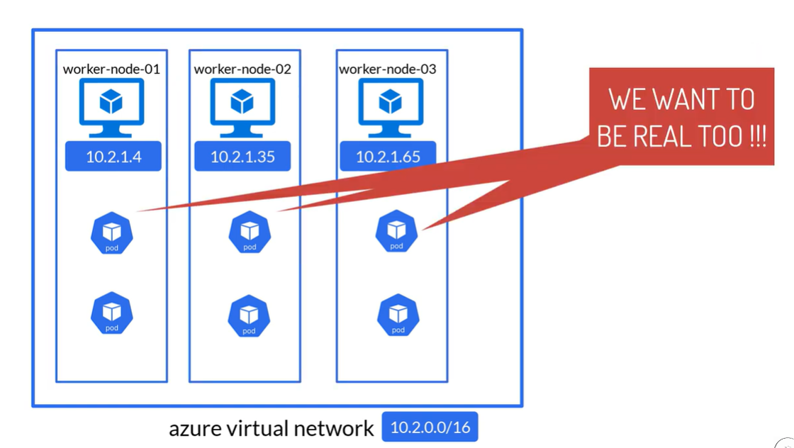

Slide 24
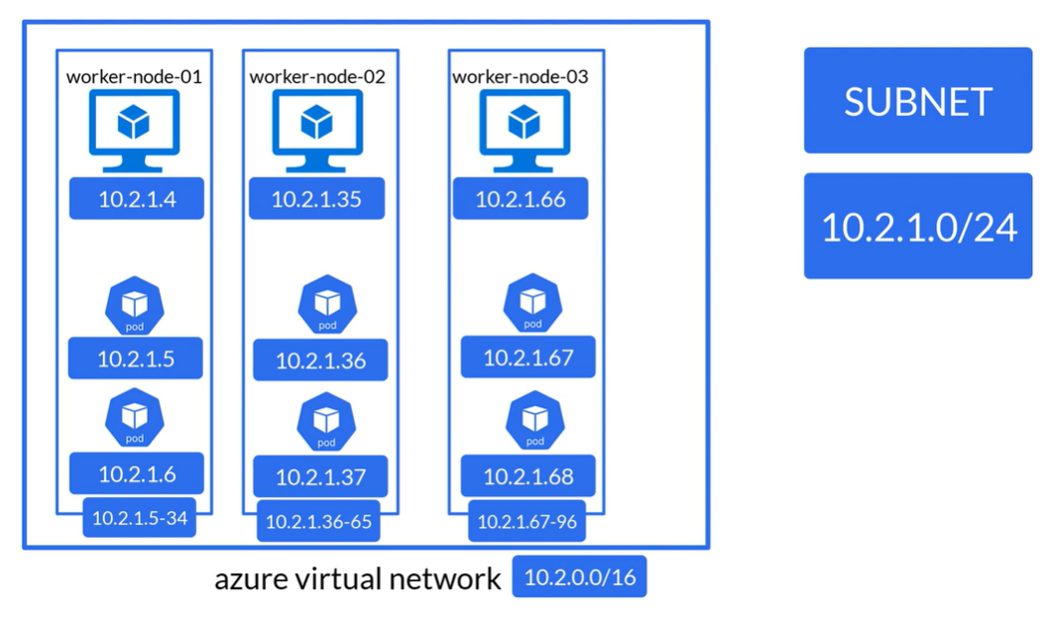

Slide 25
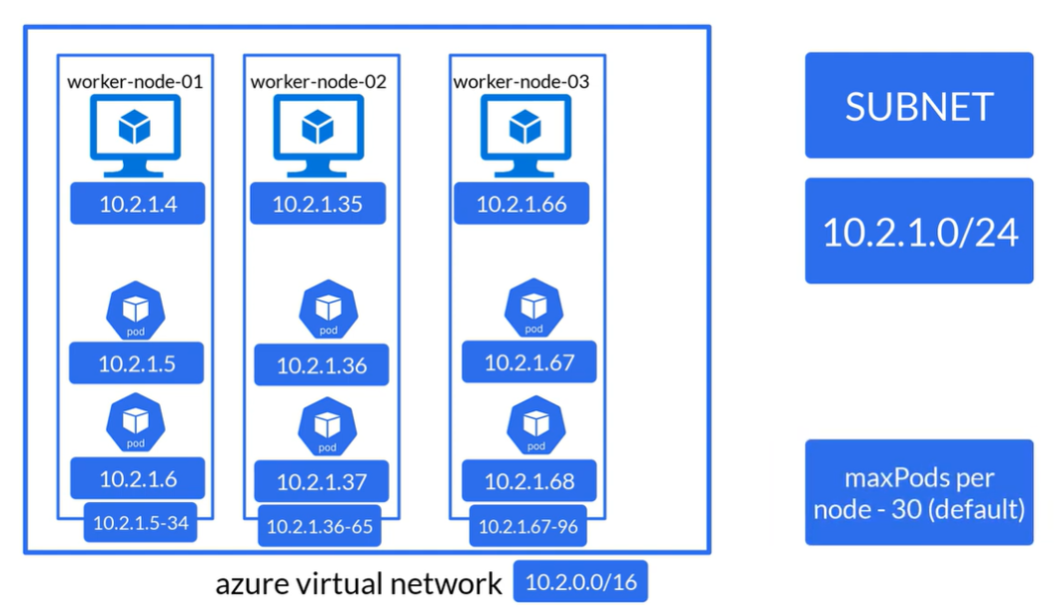

Slide 26
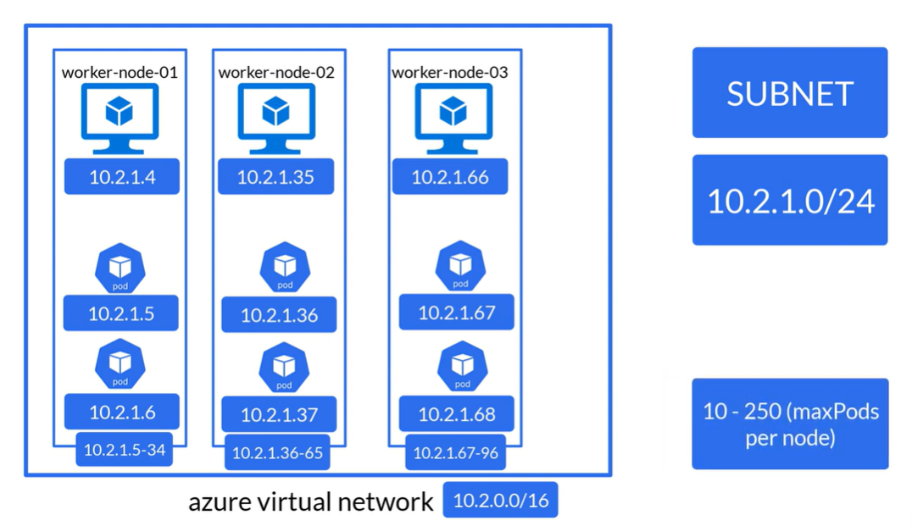

Slide 27
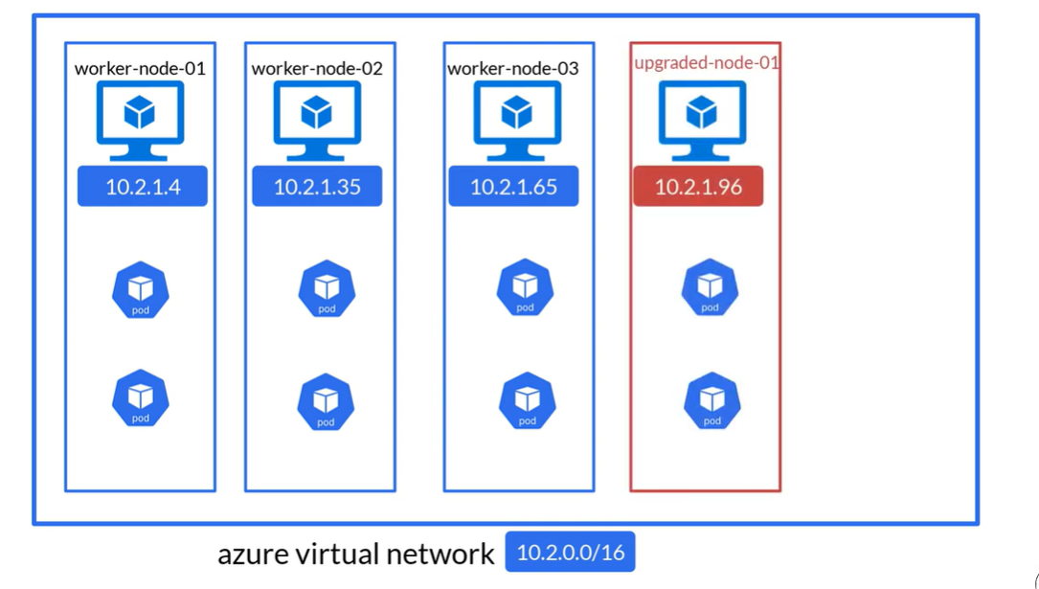

Slide 28
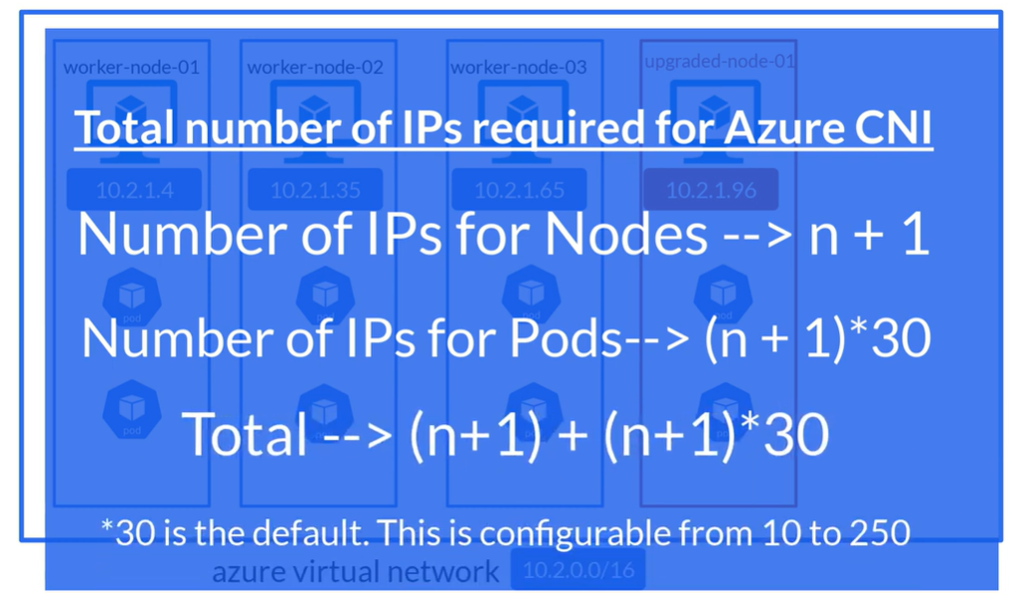

Slide 29
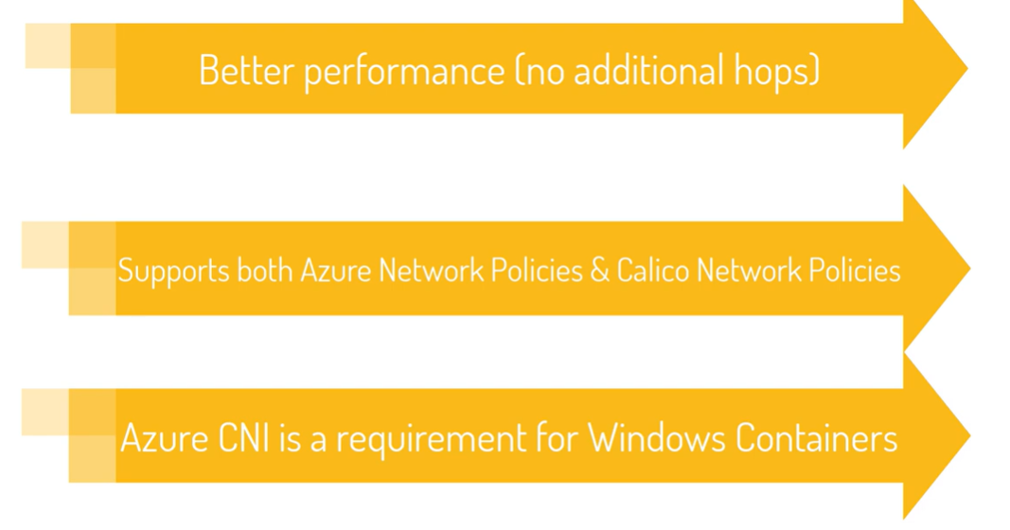

Slide 30
AKS Networking Option
Notes:
https://learn.microsoft.com/training/modules/configure-web-app-settings/

Slide 31
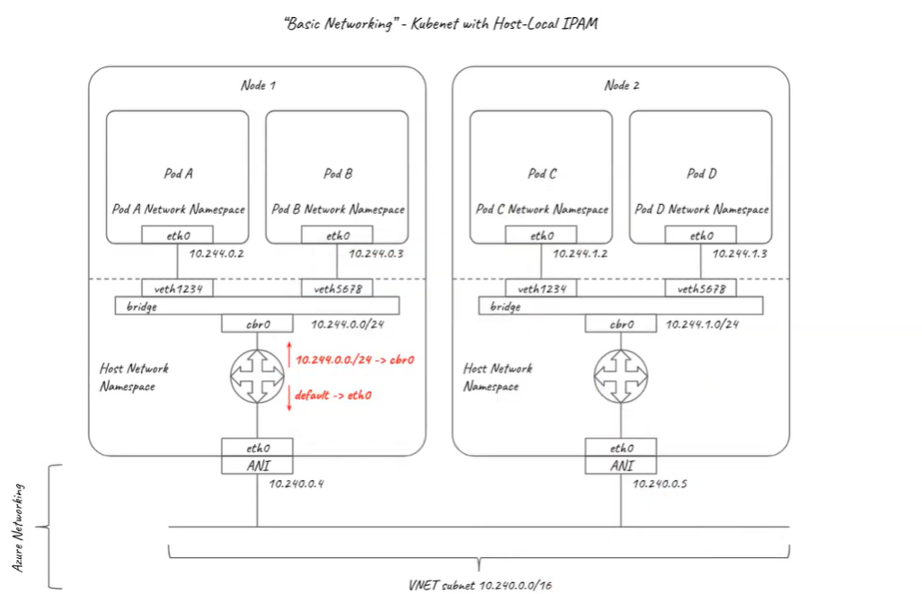

Slide 32
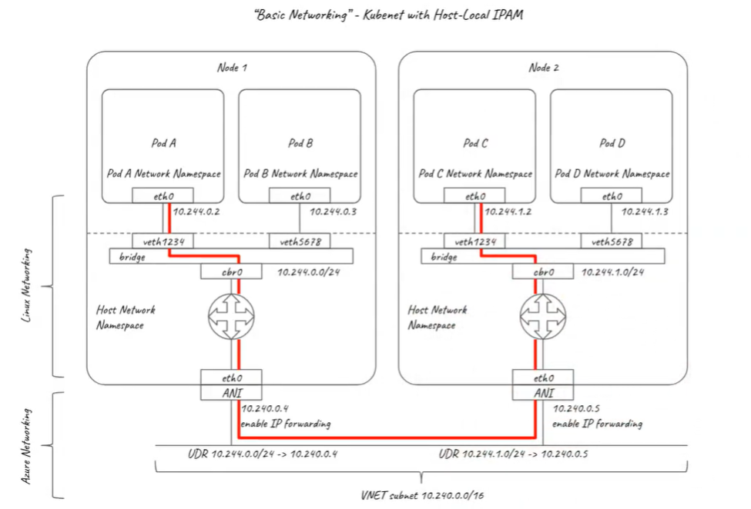

Slide 33
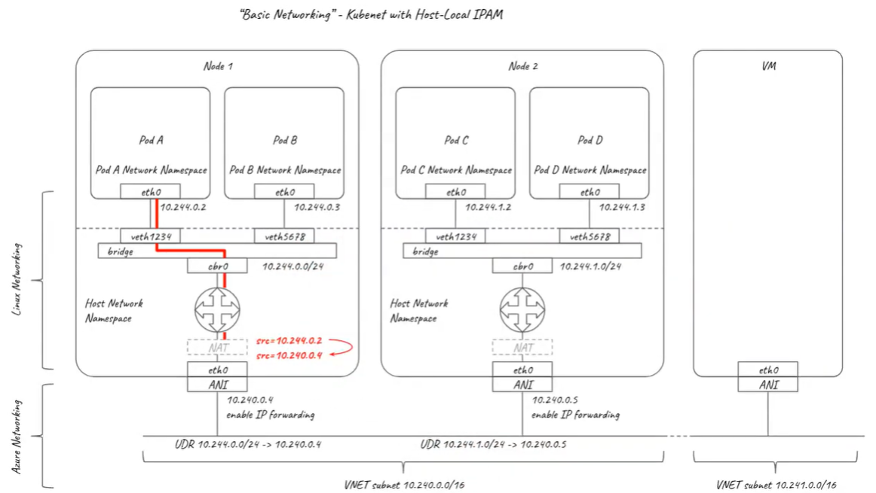

Slide 34
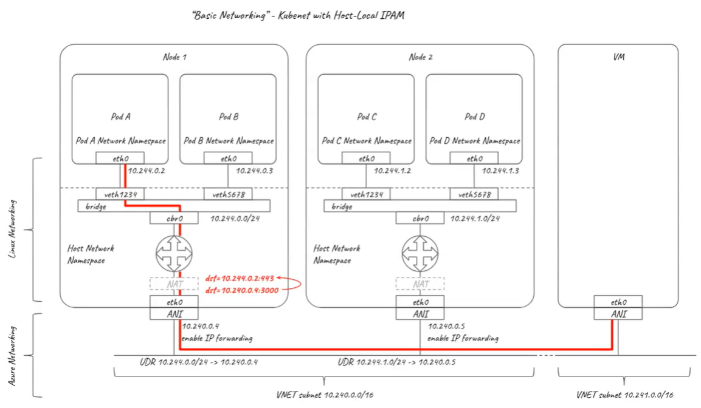

Slide 35
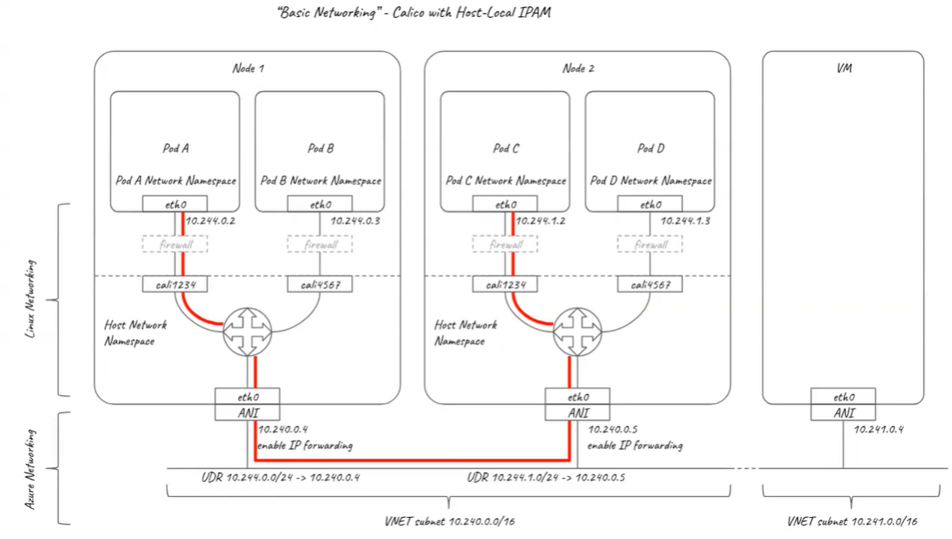

Slide 36
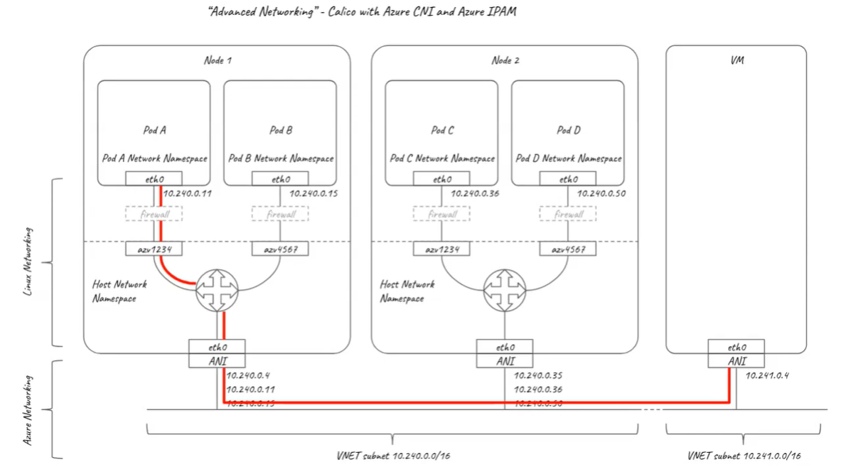

Slide 37
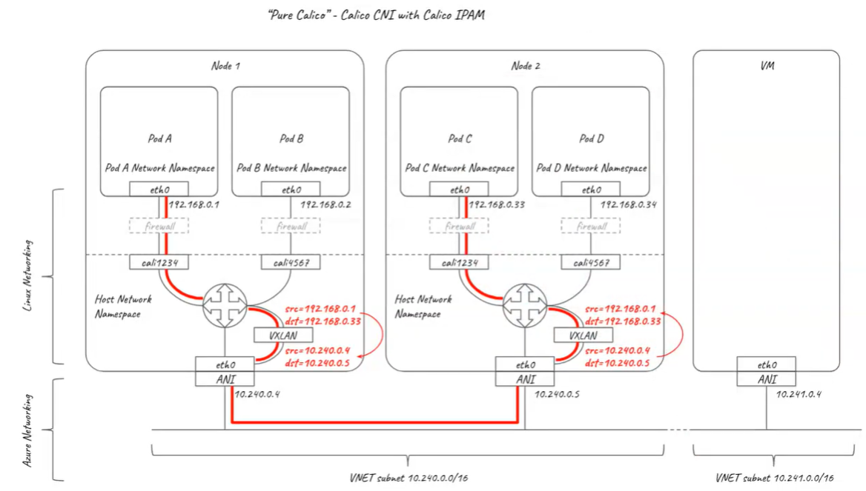

Slide 38
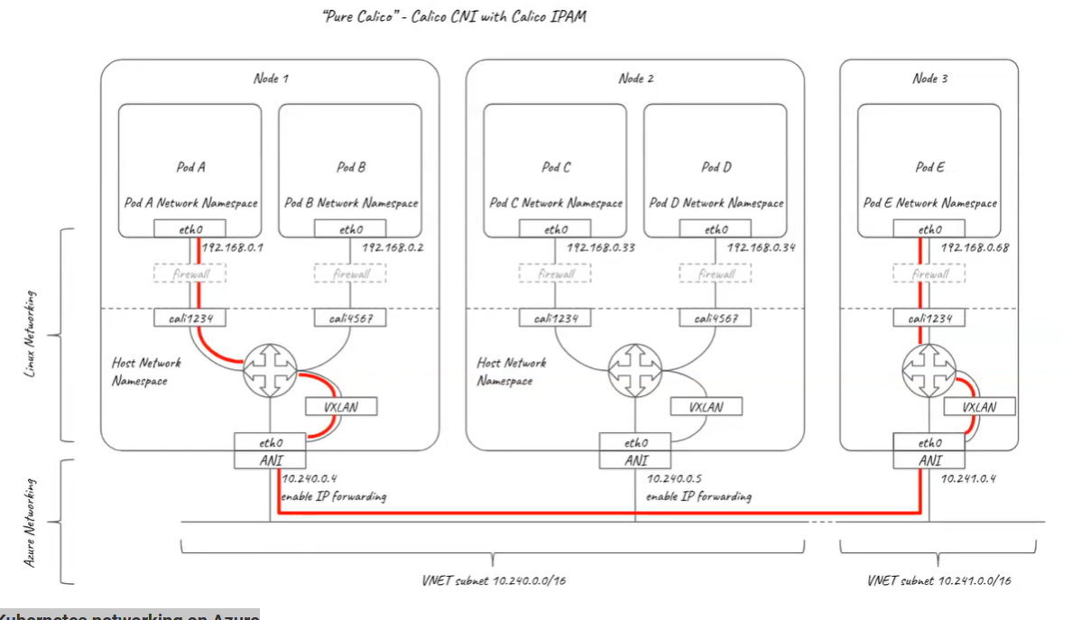

Slide 39
End of presentation

